Slide 1

OpenGL ES Introducing Texture Mapping Chapter7
Eng. Basma Hassan
Eng. Samar Shaban

Slide 2
Introduction
The art of texture mapping (along with lighting) is one of the most important parts of building up a realistic-looking 3D world.
A texture is simply an image or a picture that has been uploaded into OpenGL.

Slide 3
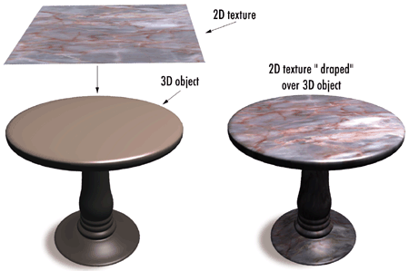
Examples 1

Slide 4
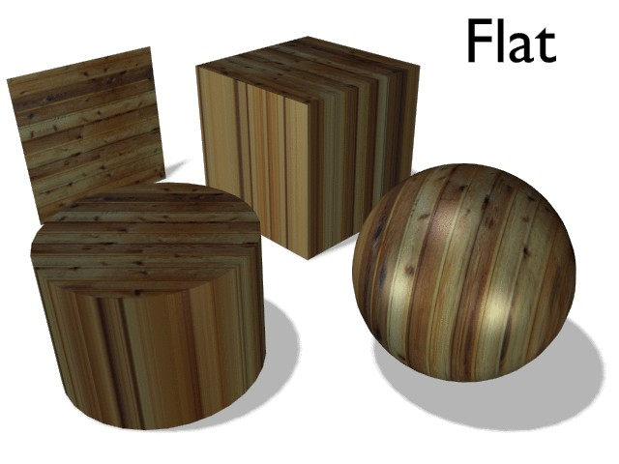
Examples 2

Slide 5
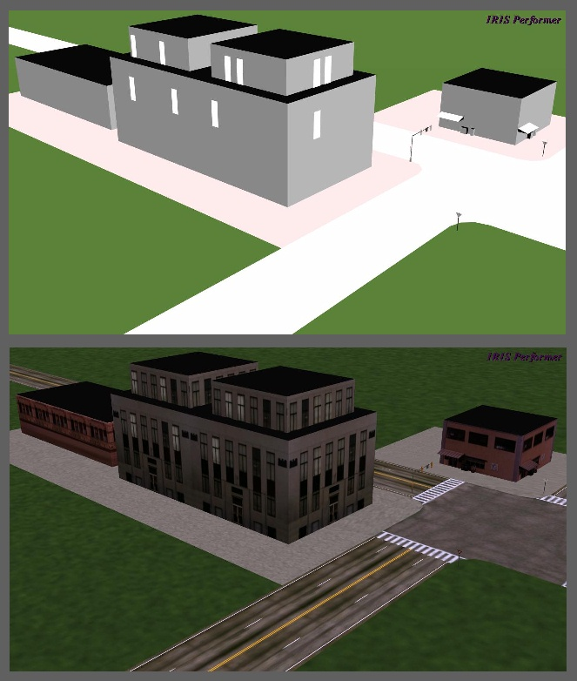
Examples 3

Slide 6
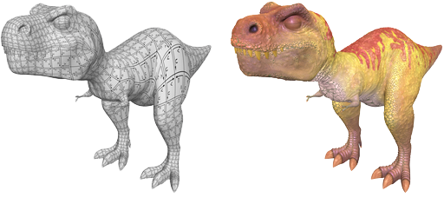
Examples 4

Slide 7
Understanding Textures
Each two-dimensional texture is composed of many small texels (small blocks of data).
The most common way to use a texture is to load in the data directly from an image file.
It is recommended to store the texture in your project’s /res/drawable-nodpi/ folder.
Texture has its own coordinate space, ranging from (0, 0) at one corner to (1, 1) at the other corner.
The two dimensions of the texture are called S and T
To apply a texture to an object, you need to specify a set of ST texture coordinates for each object vertex.

Slide 8
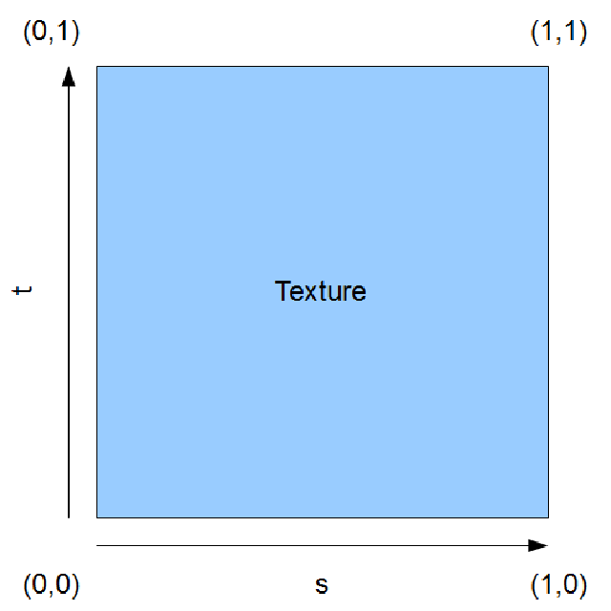
Texture Coordinate Space
Notes:
When we want to apply a texture to a triangle or set of triangles, we’ll specify a set of ST texture coordinates for each vertex so that OpenGL knows which parts of the texture it needs to draw across each triangle.

Slide 9
Loading Textures in OpenGL
In standard OpenGL ES 2.0, textures don’t have to be square, but each dimension should be a power of two (128, 256, 512, etc.)
OpenGL can’t read data from a PNG or JPEG file directly because these files are encoded into specific compressed formats.
OpenGL needs the raw data in an uncompressed form, so we’ll need to use Android’s built-in bitmap decoder to decompress our image files into a form that OpenGL understands.

Slide 10
Texture Filtering
When we draw a texture onto the rendering surface, the texture’s texels may not map exactly onto the fragments generated by OpenGL.
There are two cases:
Minification: happens when several texels are crammed onto the same fragment.
Magnification: happens when one texel is spread across many fragments.
OpenGL must be configured to use a texture filter for each case.

Slide 11
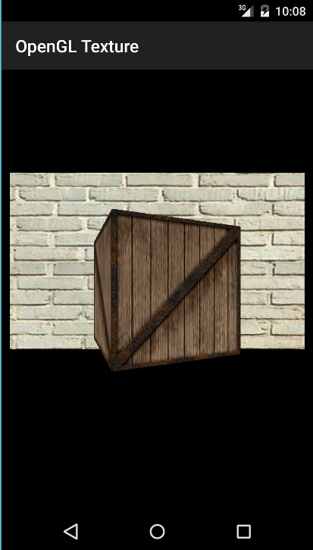
Our Program

Slide 12
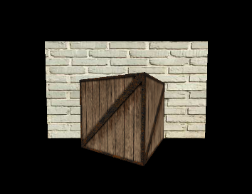
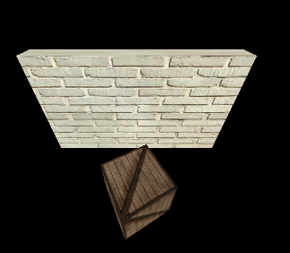
Our Program

Slide 13

COURSE END
Prepare any questions you have for coming lab

